Slide 1
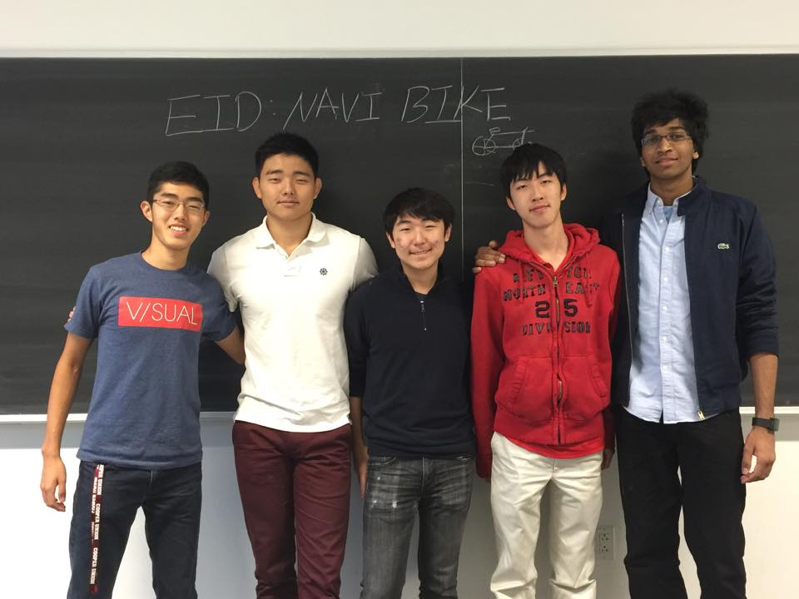
Navi-Bike
Jai
Bob
Jimmy
Paul
Chris

